Slide 1
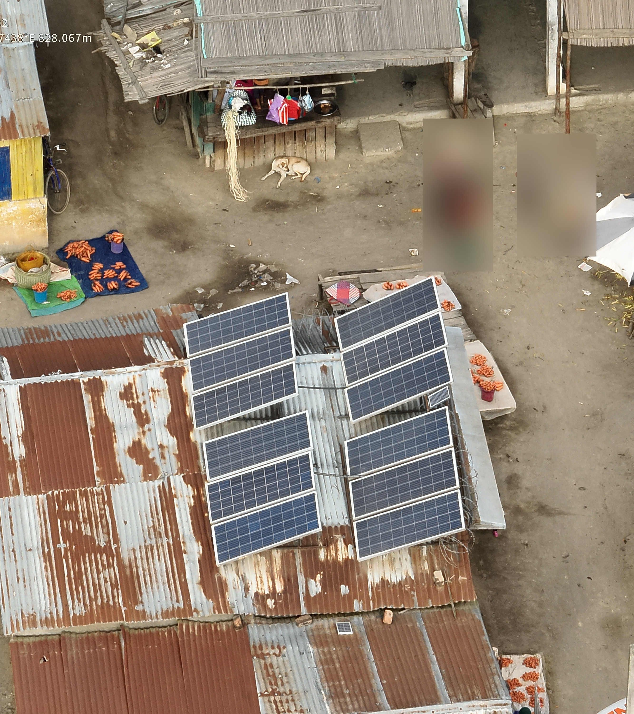
Counting Photovoltaic and Solar Panels from Aerial Imagery
Complements of Machine Learning 24/25
Lacuna Solar Survey Challenge
Hugo Veríssimo 124348
João Cardoso 50750

Slide 2

contents
Project Overview
Data Analysis
Deep Learning Models
Results Analysis

Slide 3
Project Overview

Slide 4
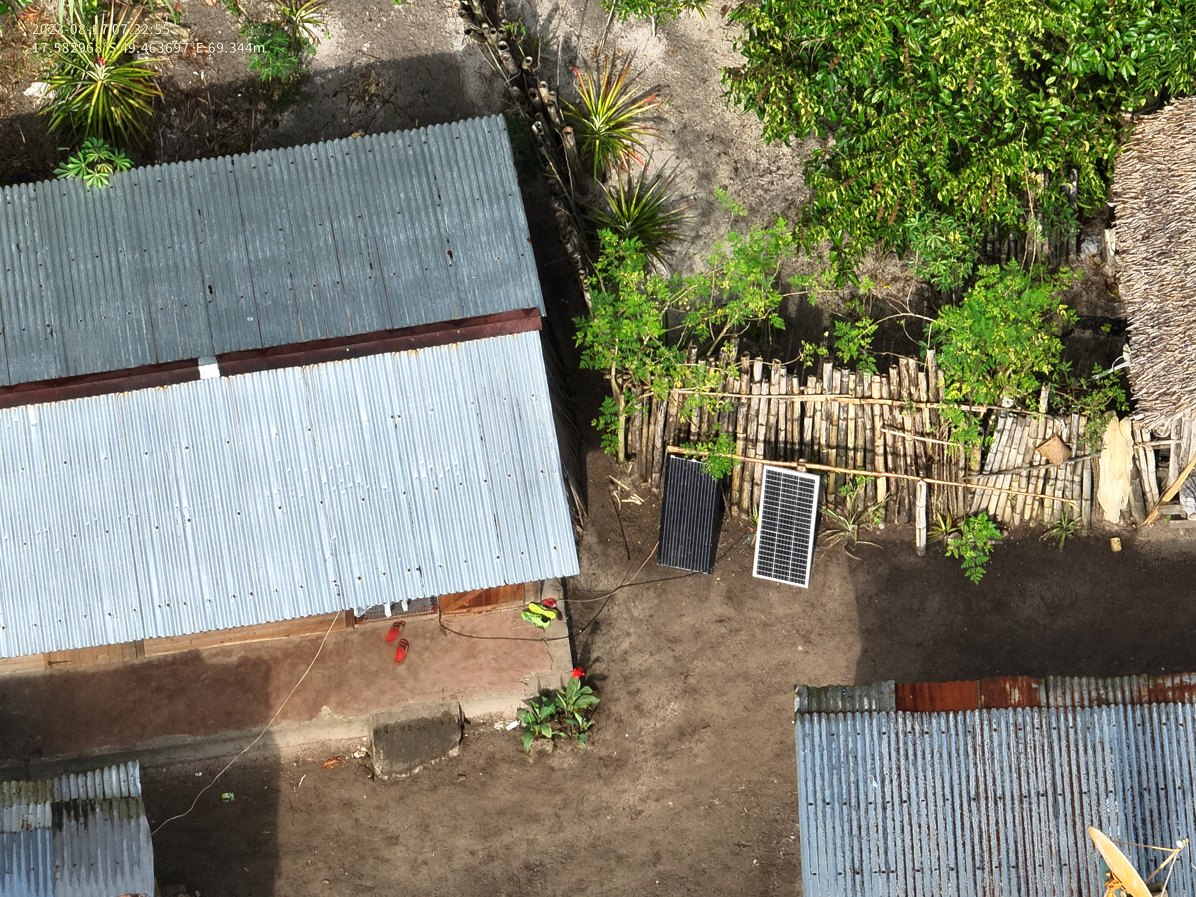
The problem
From aerial imagery:
Count thermal solar panels
Count photovoltaic panels

Slide 5
State of the art

Slide 6
Data analysis

Slide 7
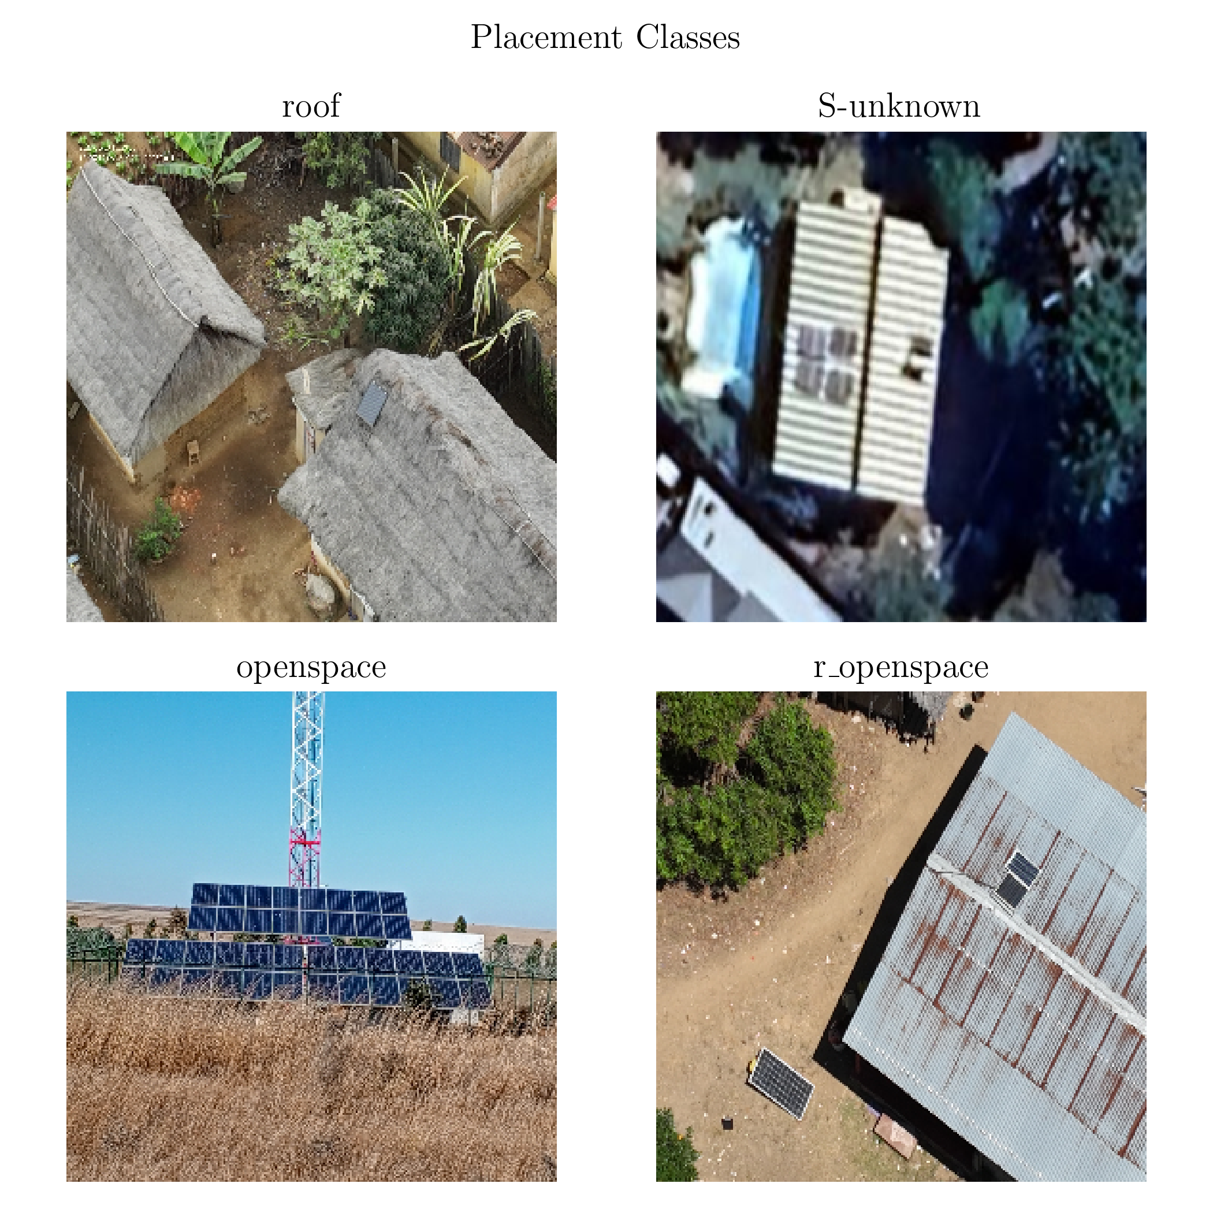
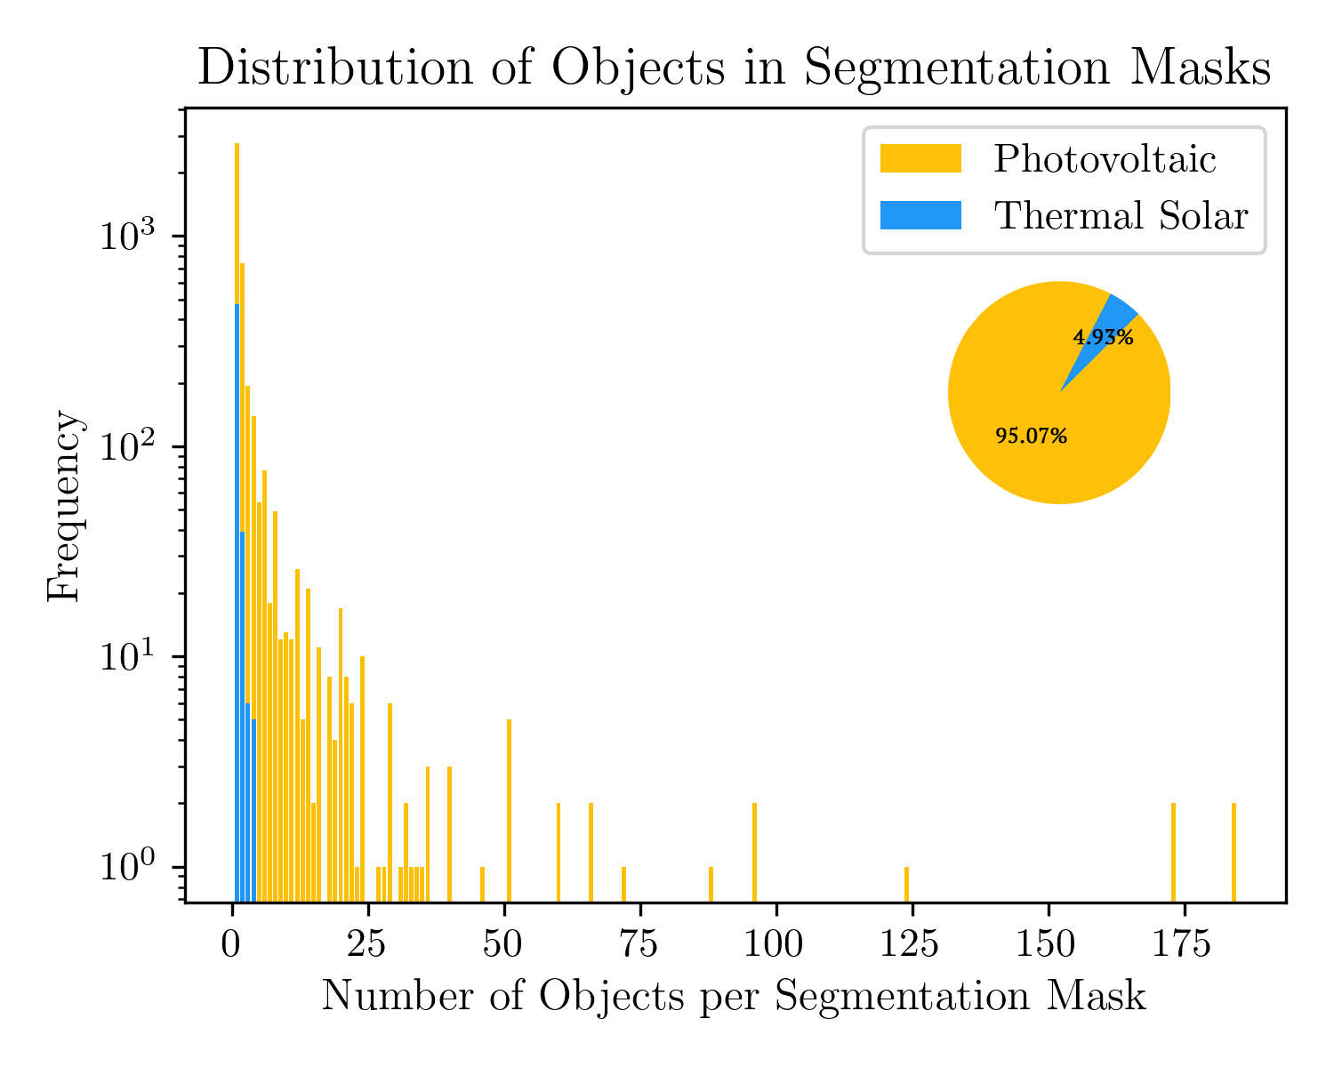
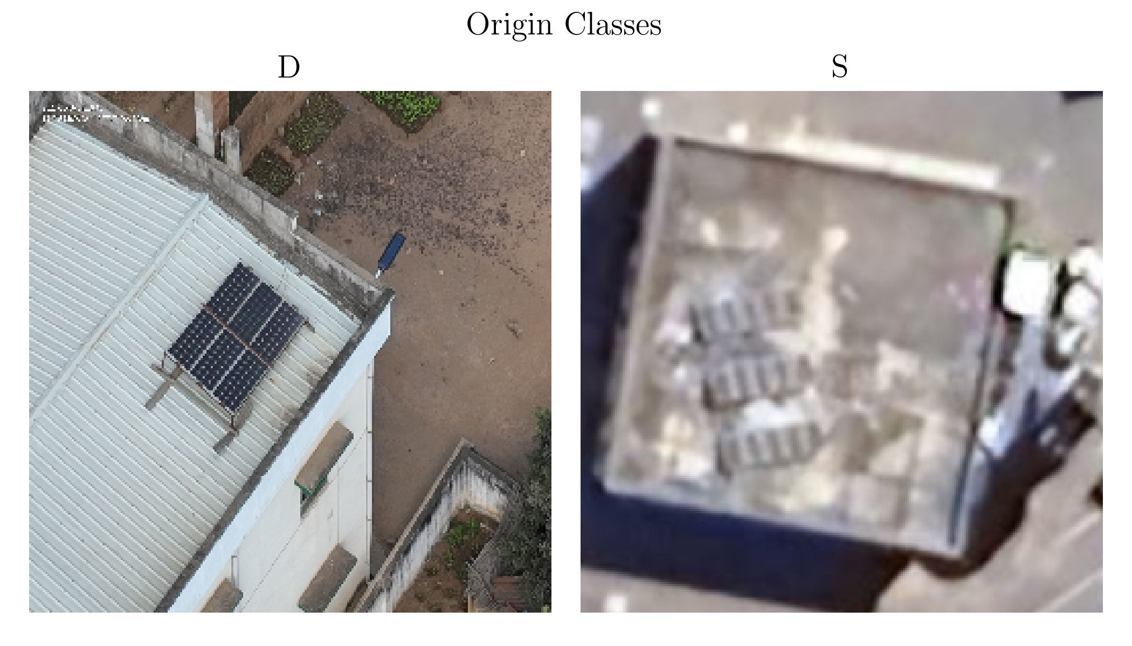
Raw data
4419 images (75/25)
Segmentation masks for panel groups
Metadata

Slide 8
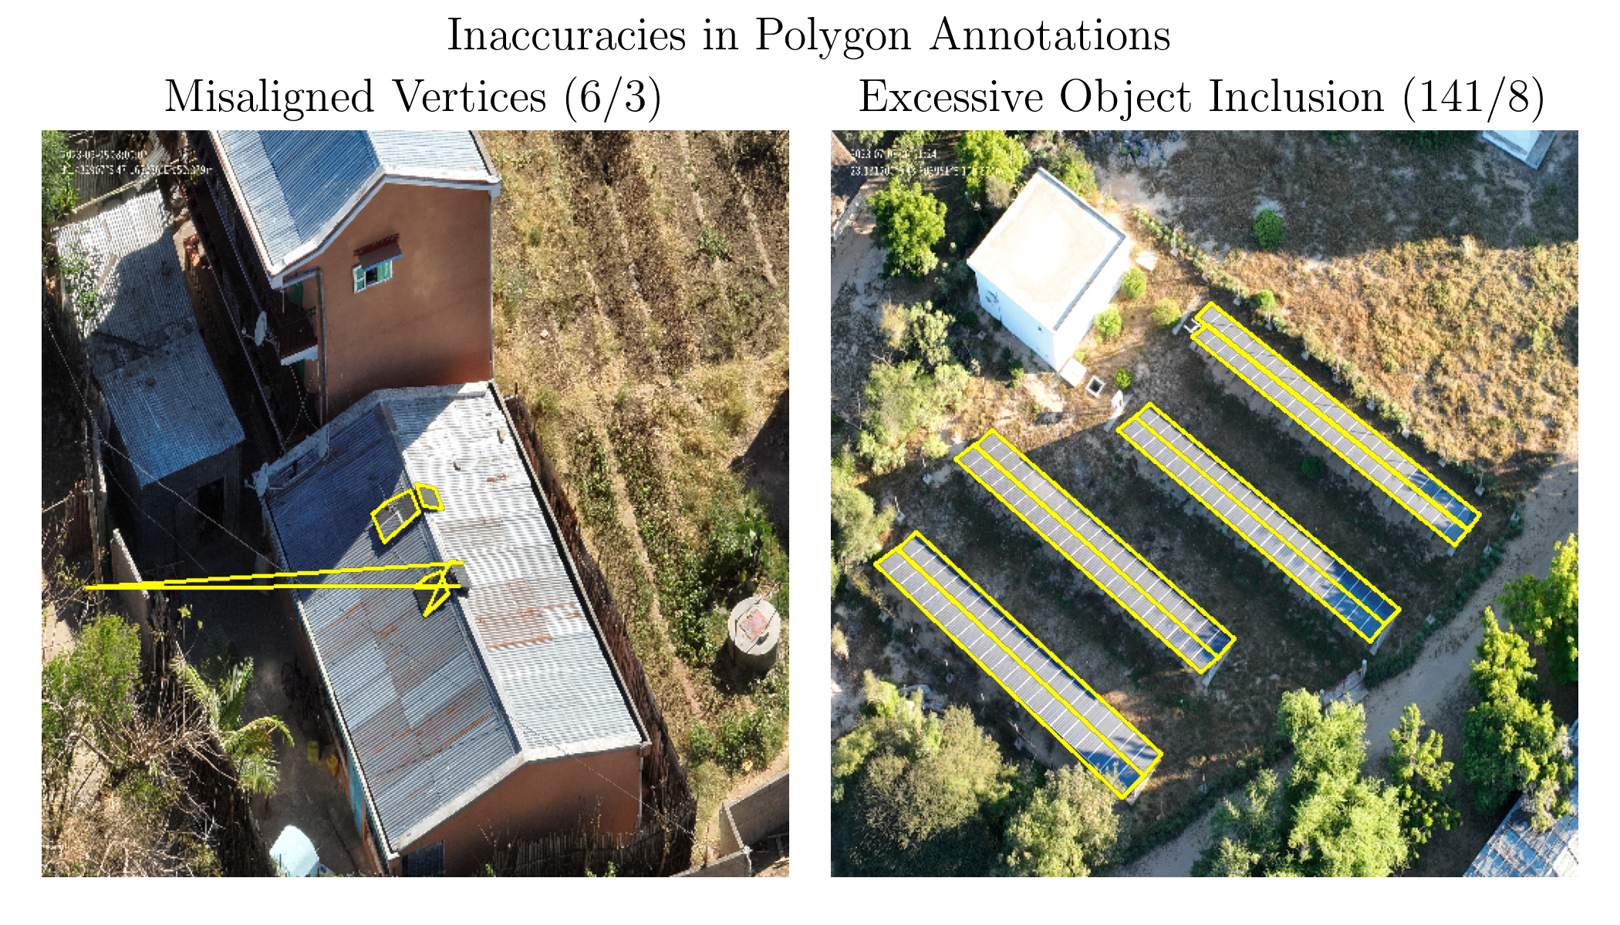
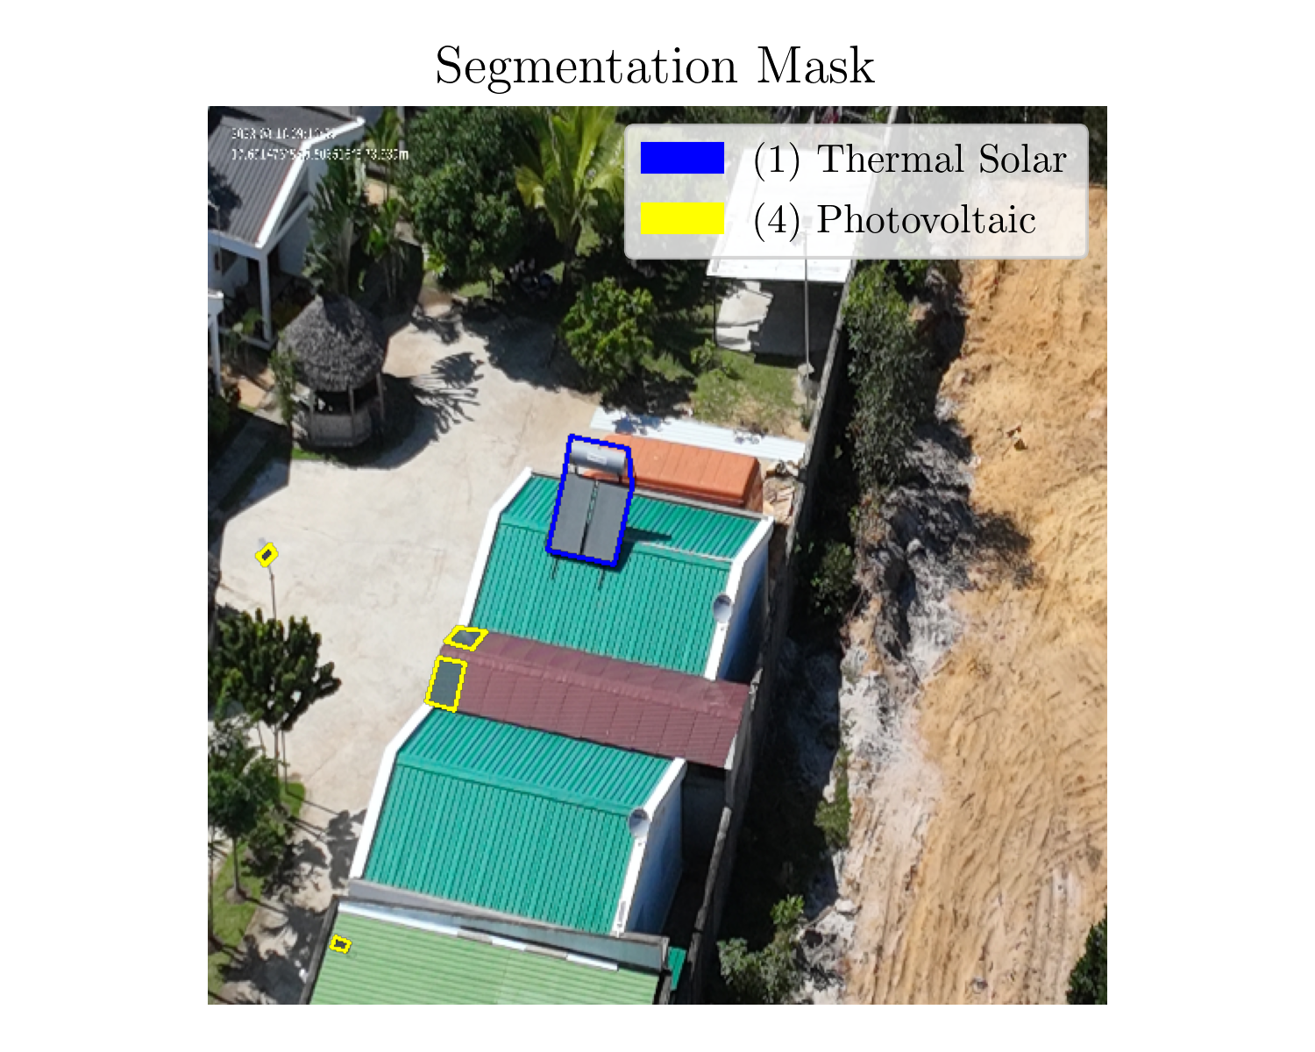
Preprocessing
Fix or remove innacurate polygons
Resize images to 512 x 512

Slide 9
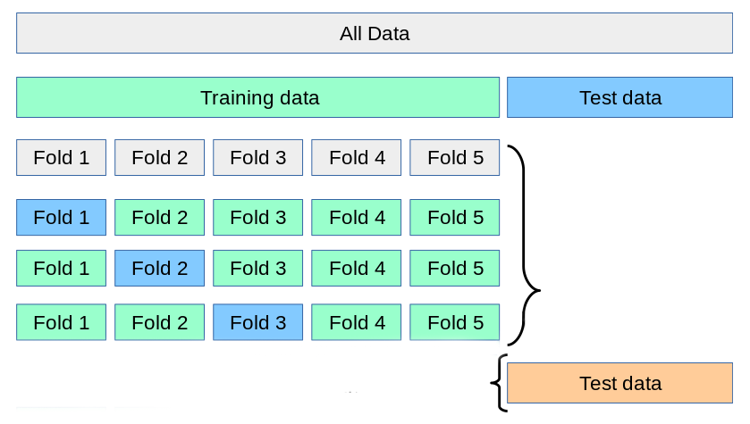
Deep learning models

Slide 10
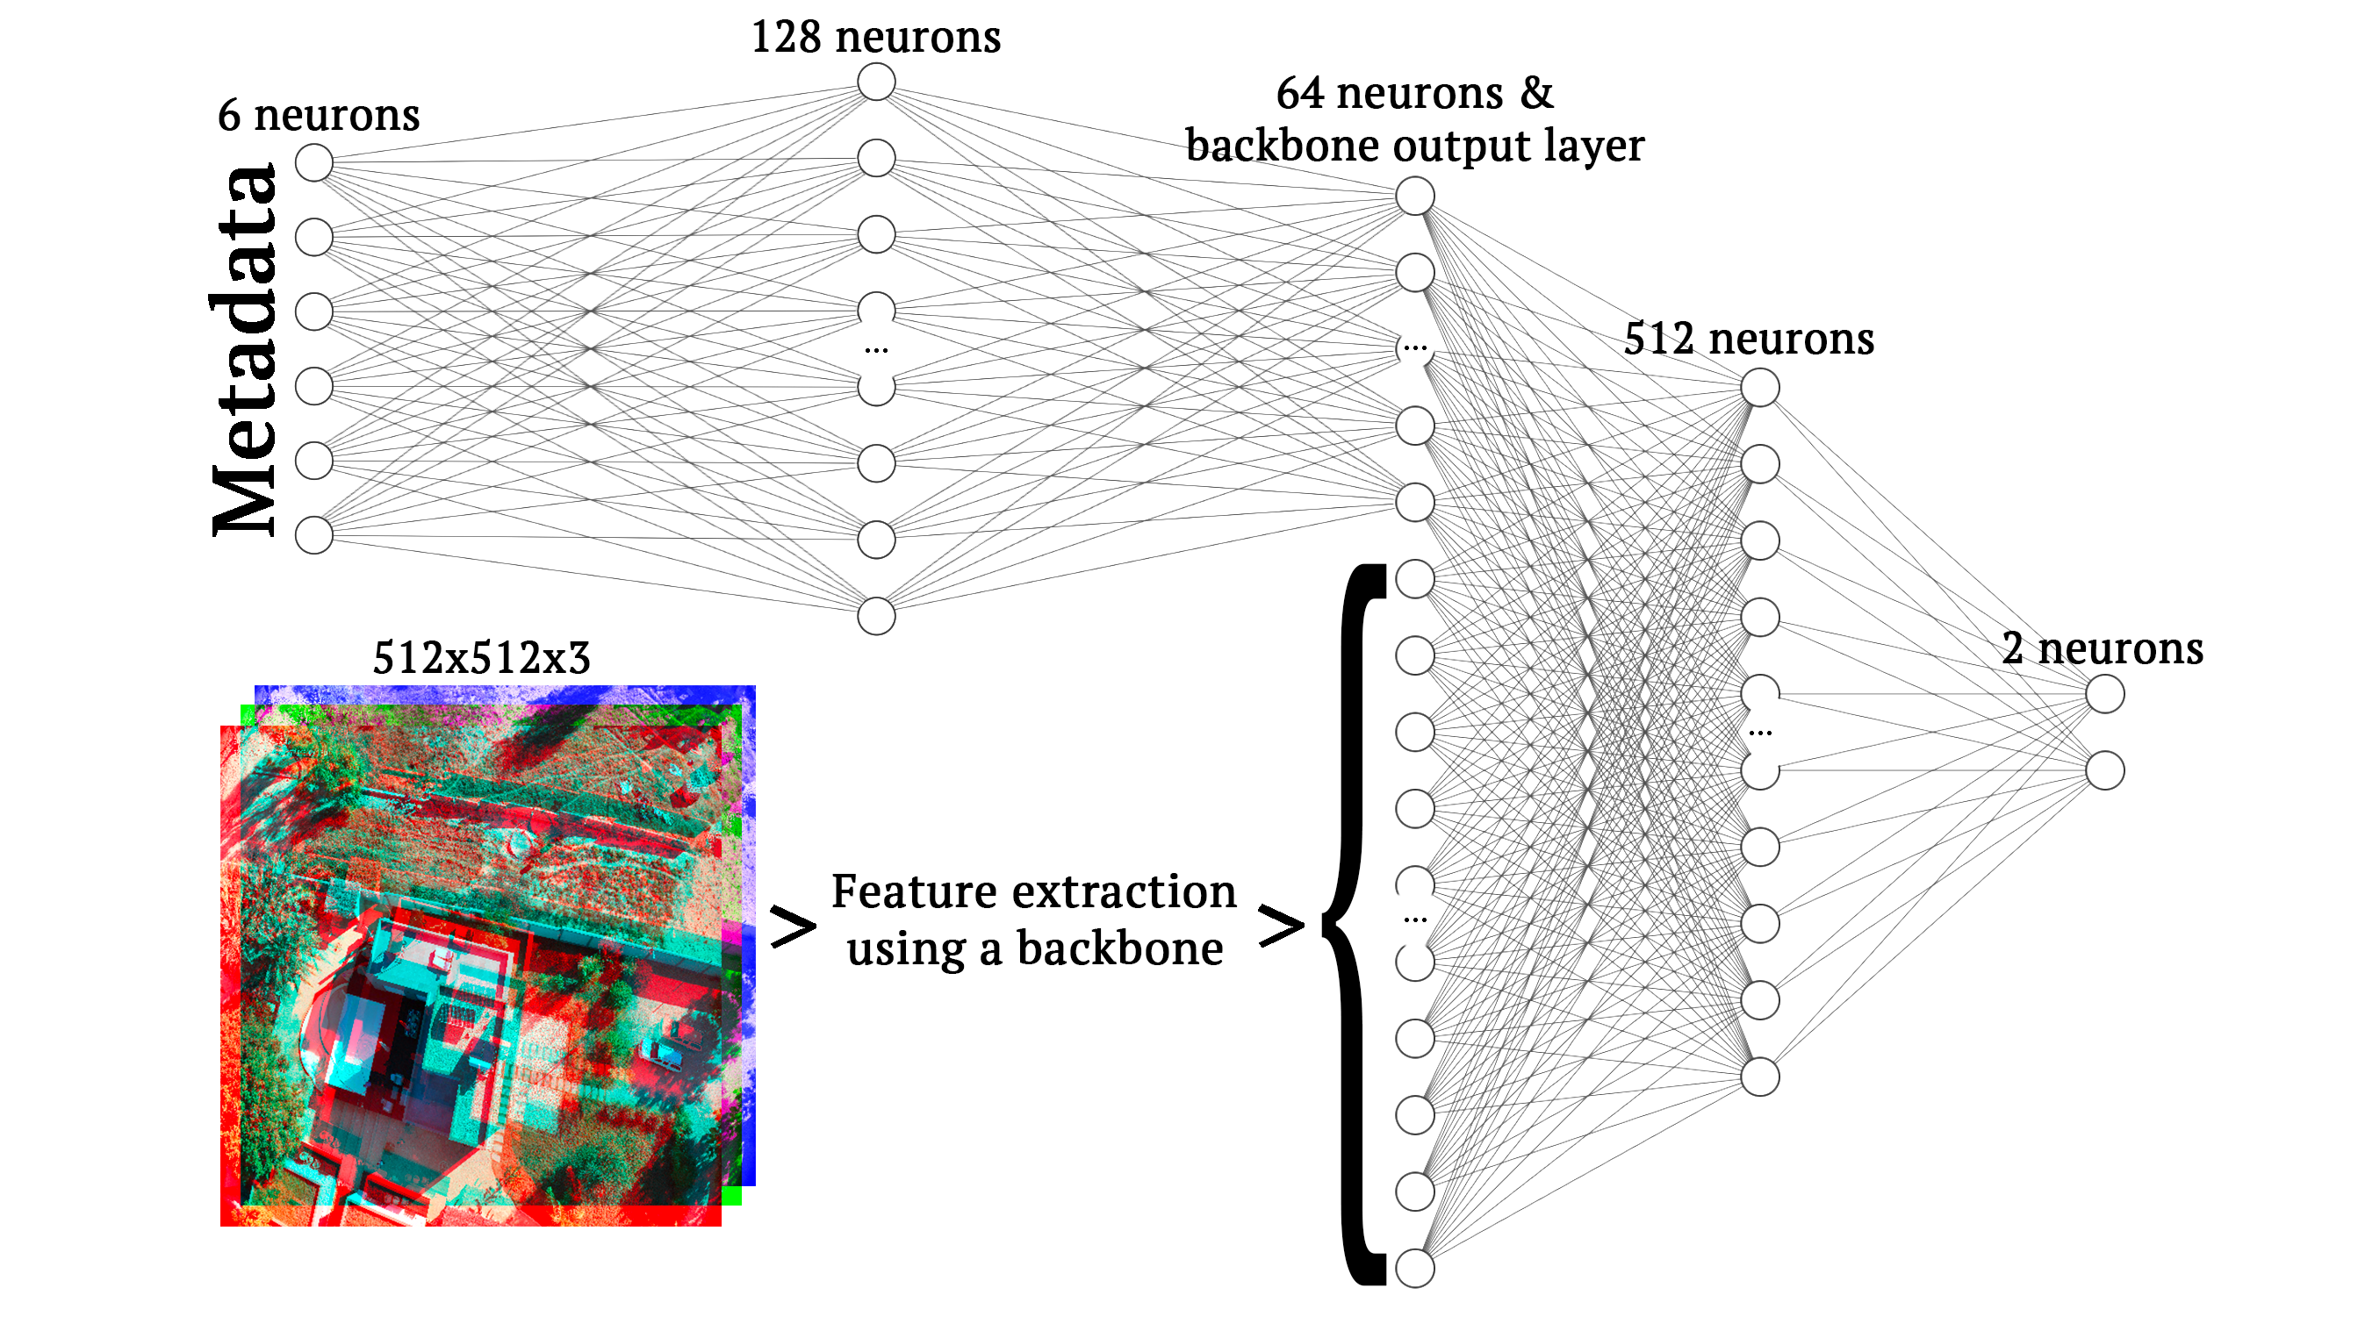
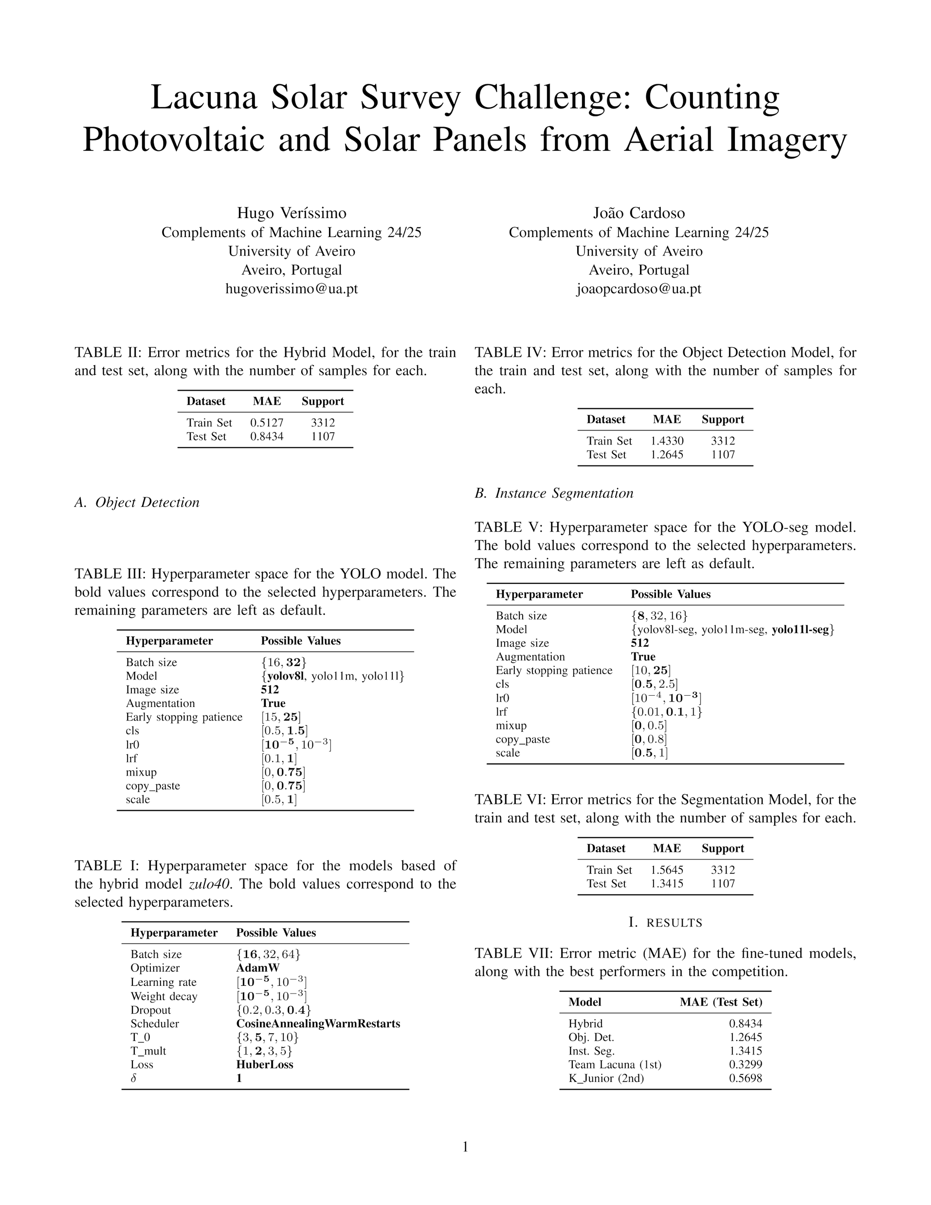
Image-based Regression
DenseNet121, EfficientNetv2B3 and ResNet101
Hyperparameter search space

Slide 11
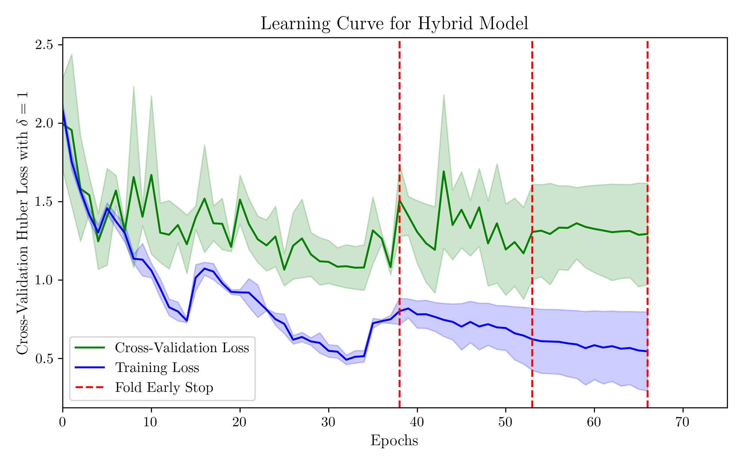
Image-based Regression - results
Error metrics

Slide 12
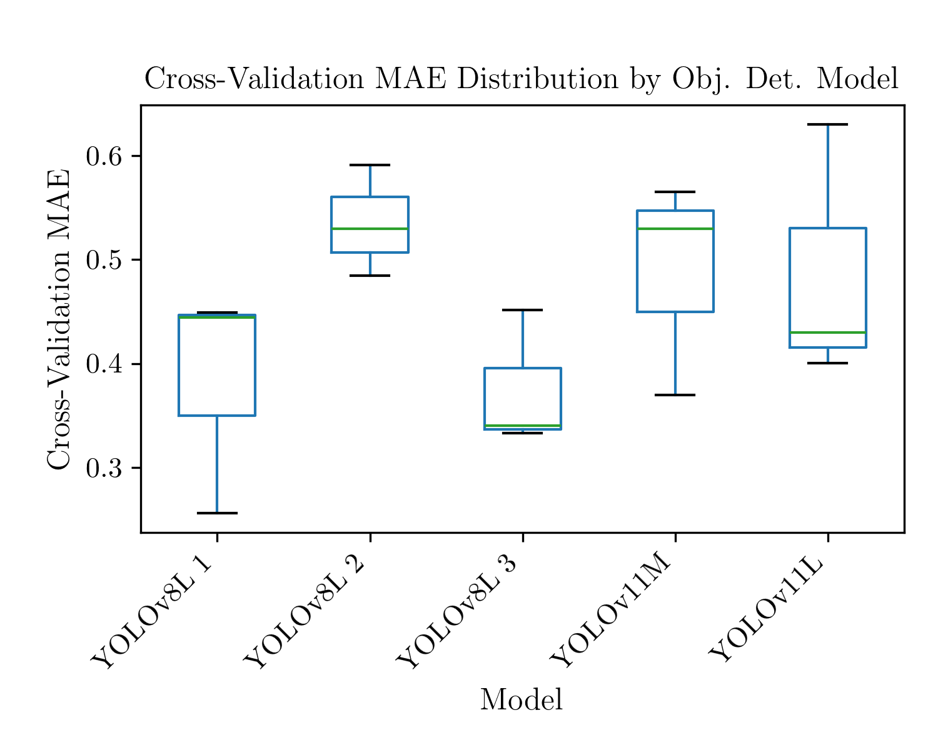
Object detection
Hyperparameter search space

Slide 13
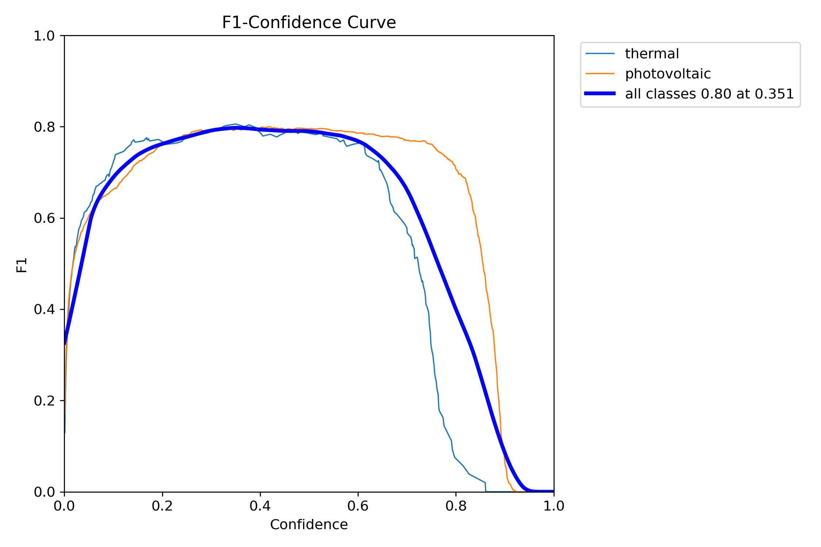
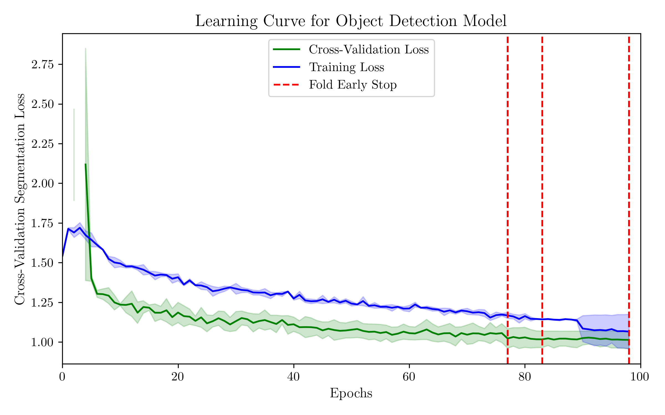
Object detection - results
Error metrics

Slide 14
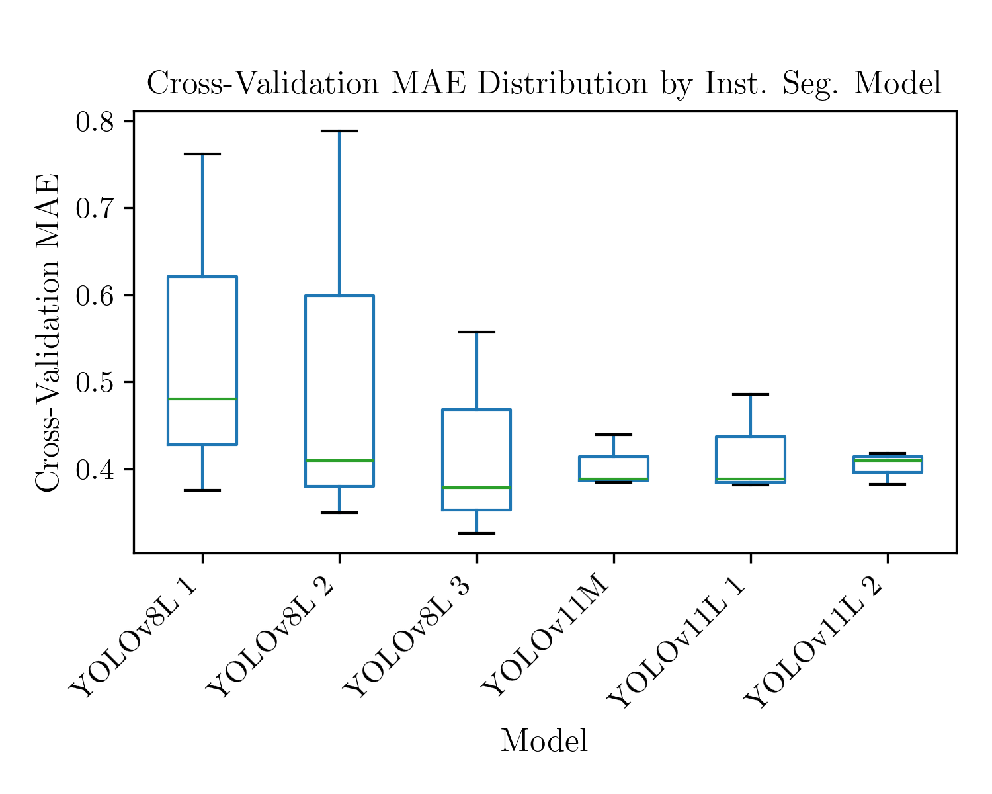
Instance segmentation
Hyperparameter search space

Slide 15
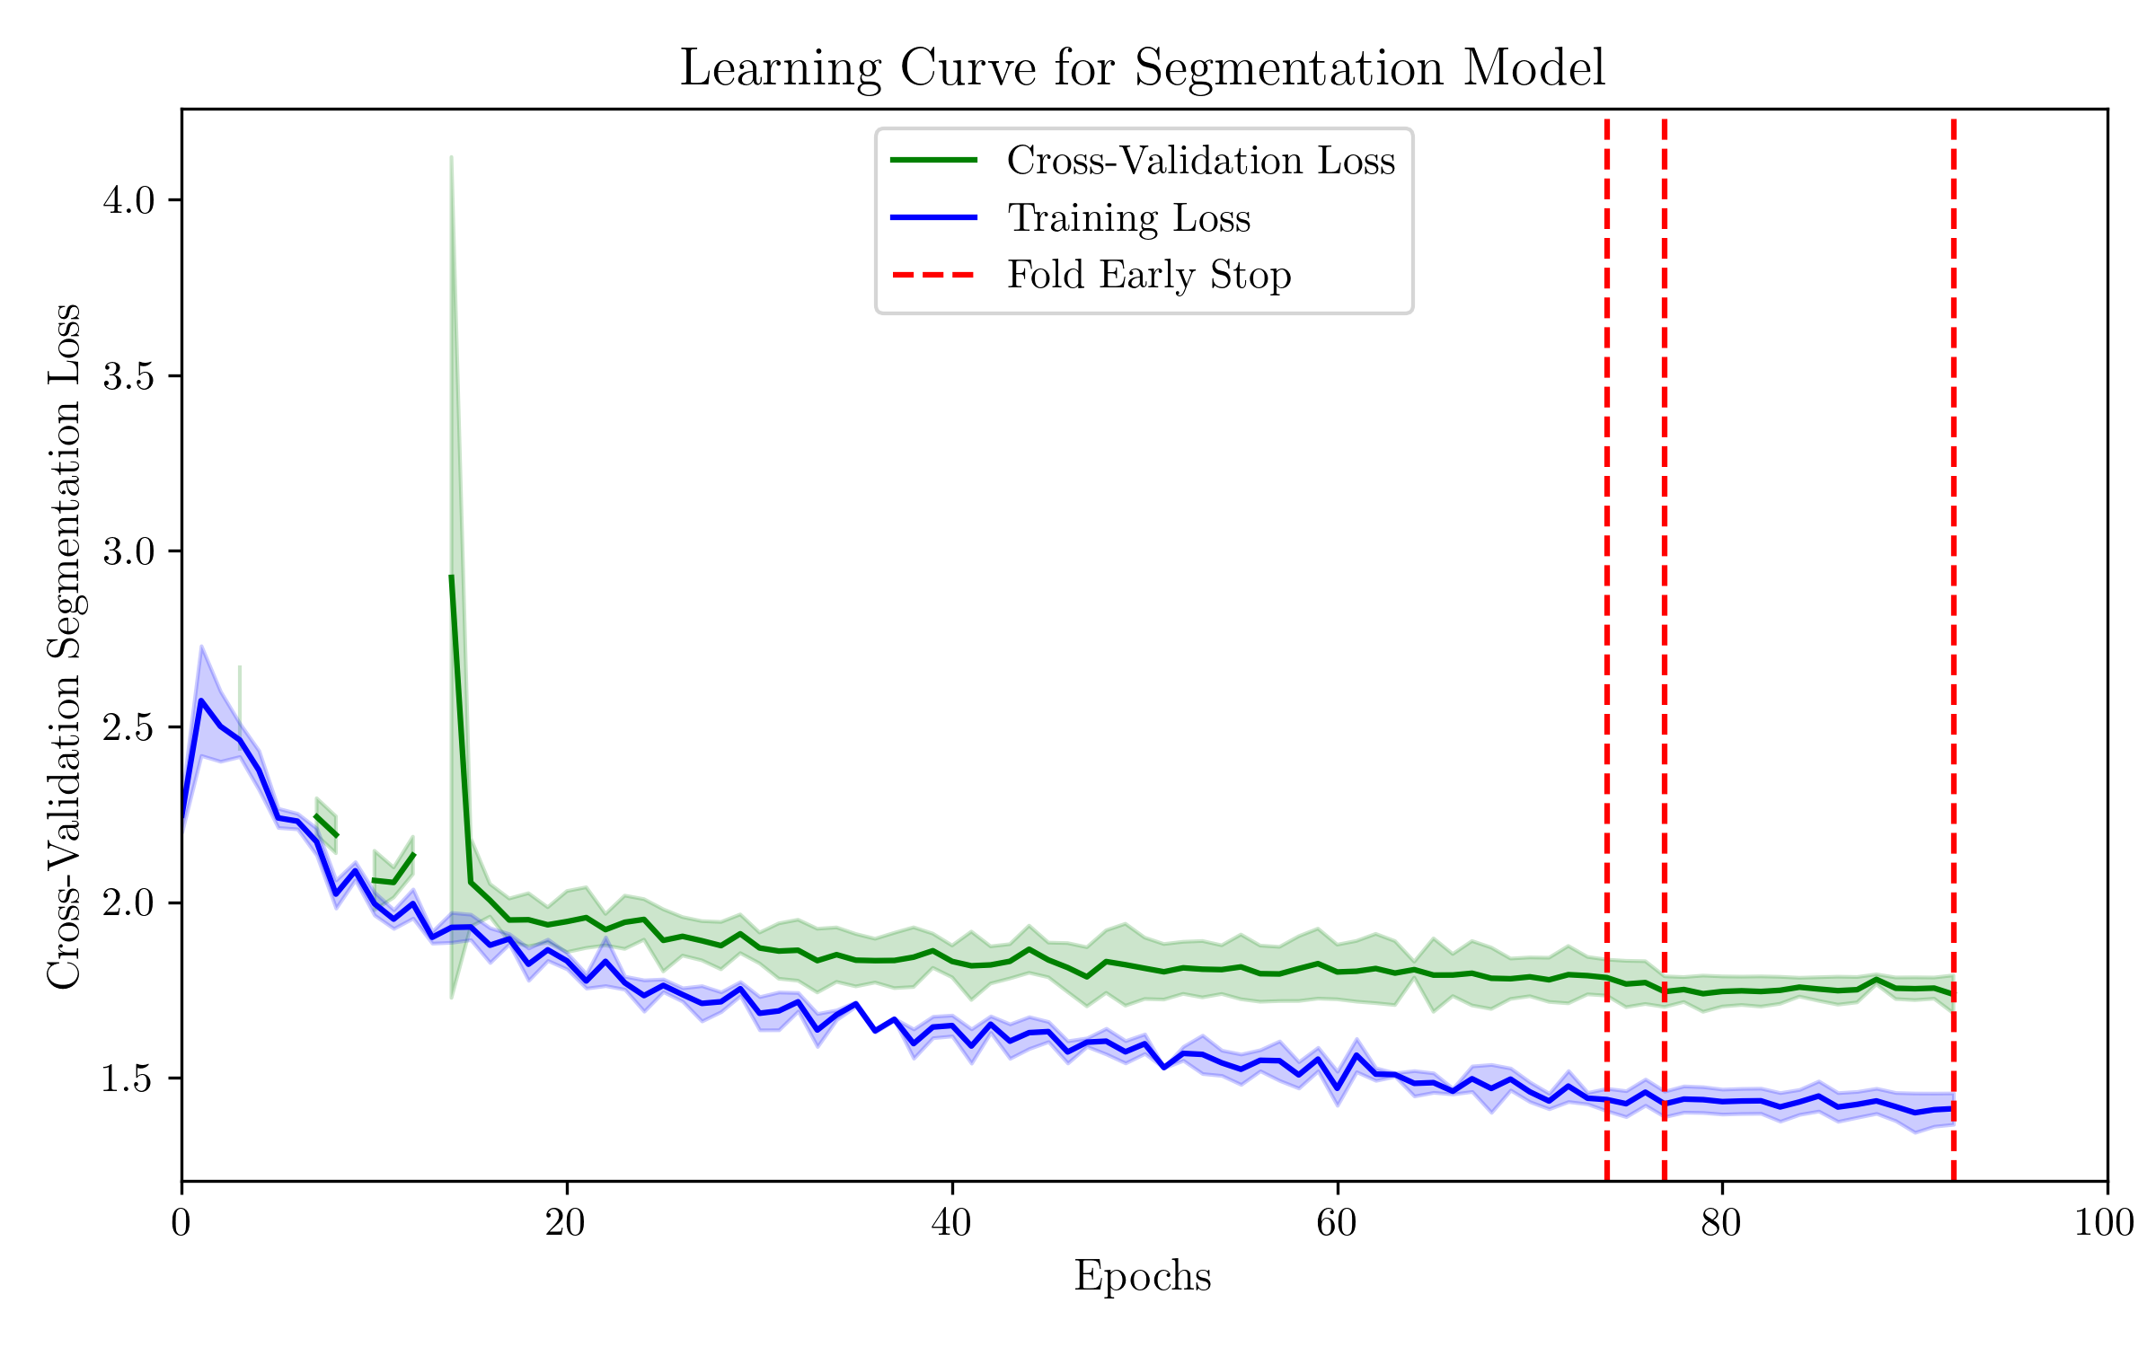
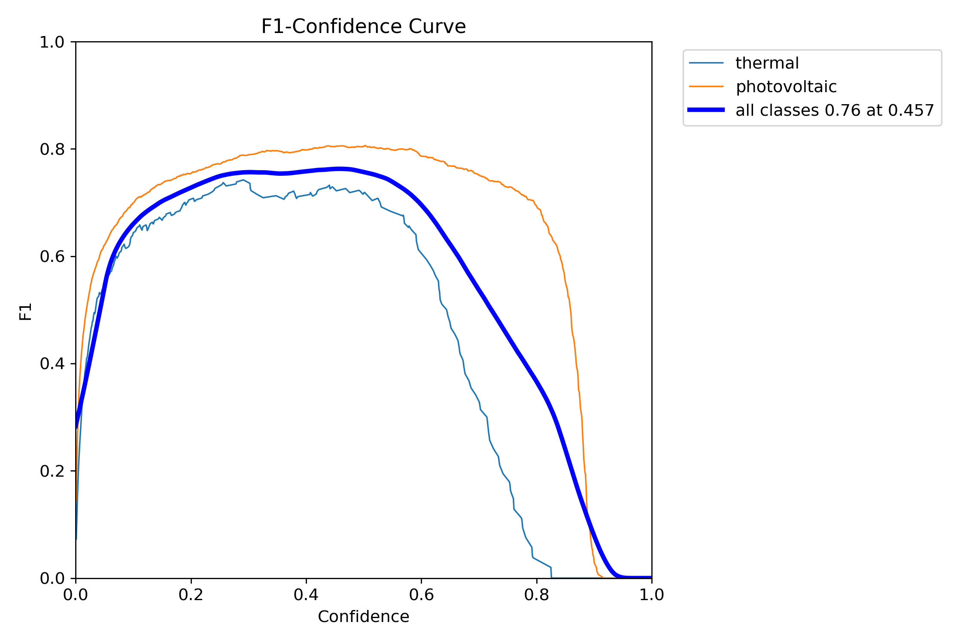
Instance segmentation - results
Error metrics

Slide 16
Results analysis

Slide 17
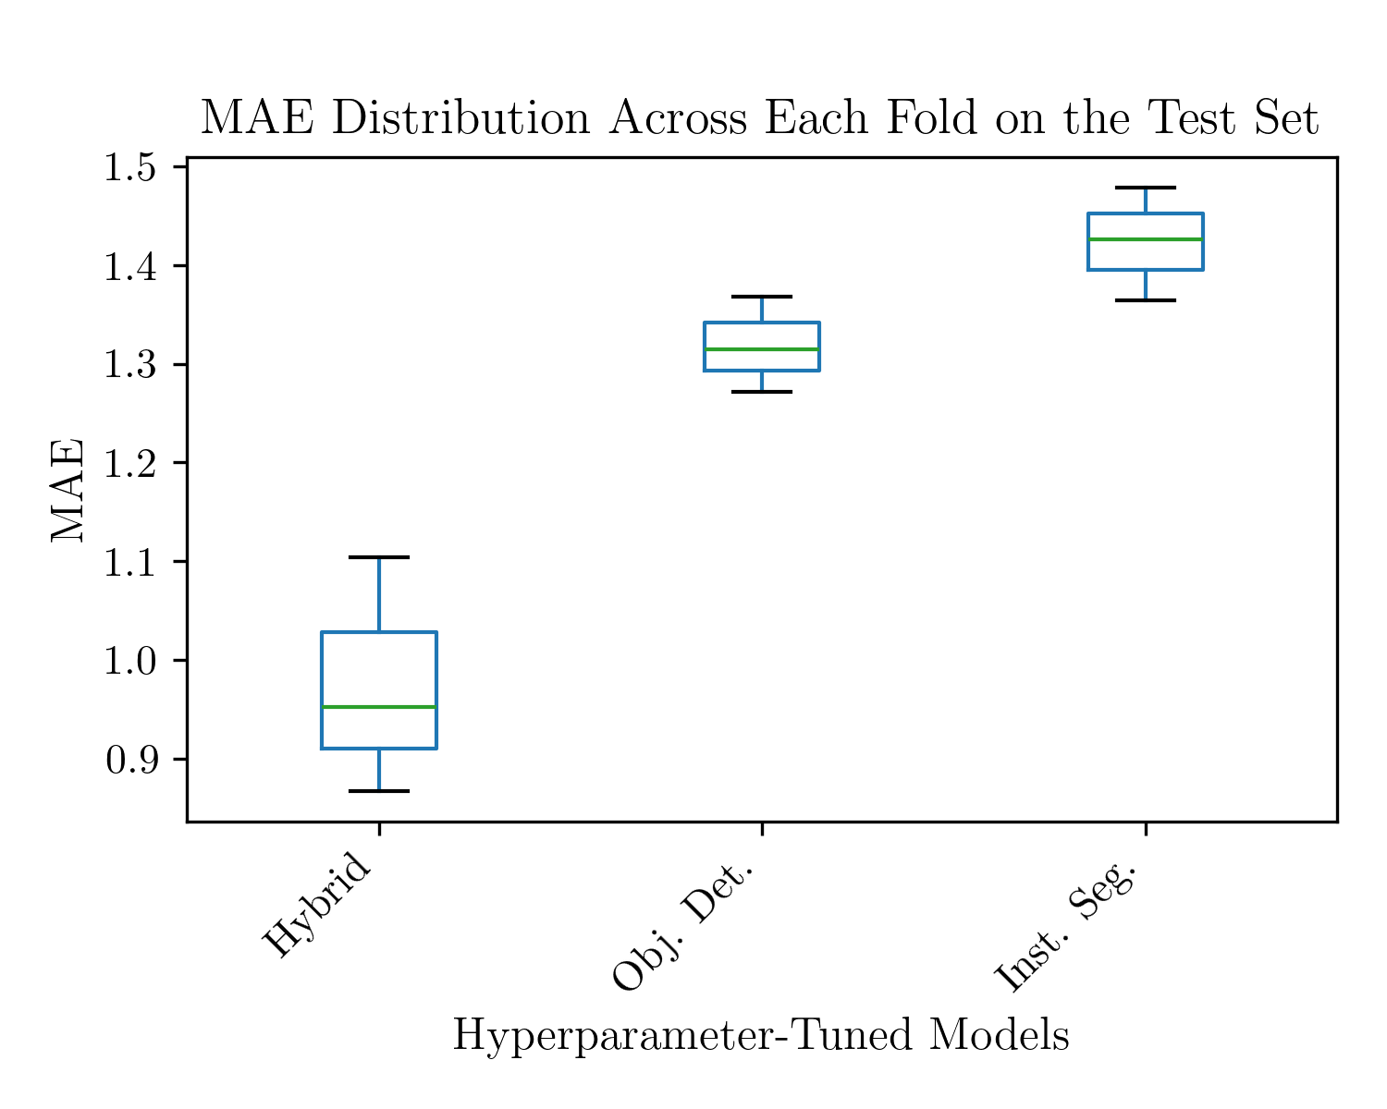
Error metrics for the fine-tuned models along with the best performers in the competition

Slide 18
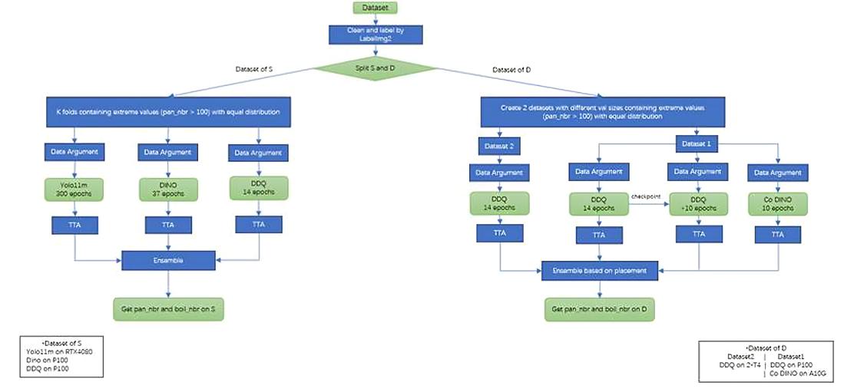
Aka discussion w lit benchmark

Slide 19
conclusions

